Slide 1
A.N.T.S.
AMERICAN NATIONAL TRANSPORTATION SYSTEM

Slide 2

A.N.T.S. CREATES

Slide 3

ENERGY

Slide 4
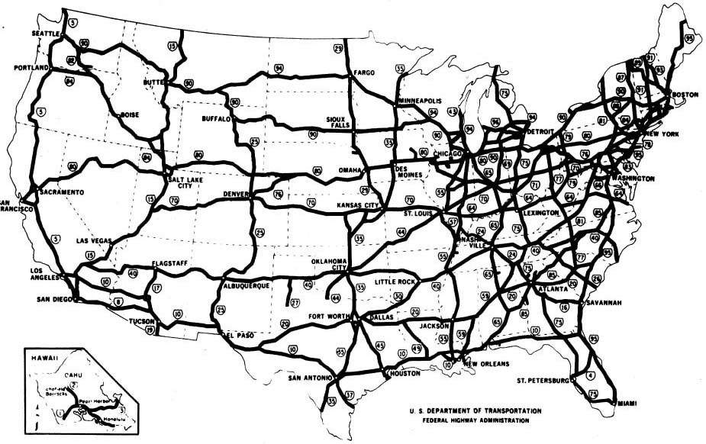

Slide 5

COMMUNICATIONS

Slide 6
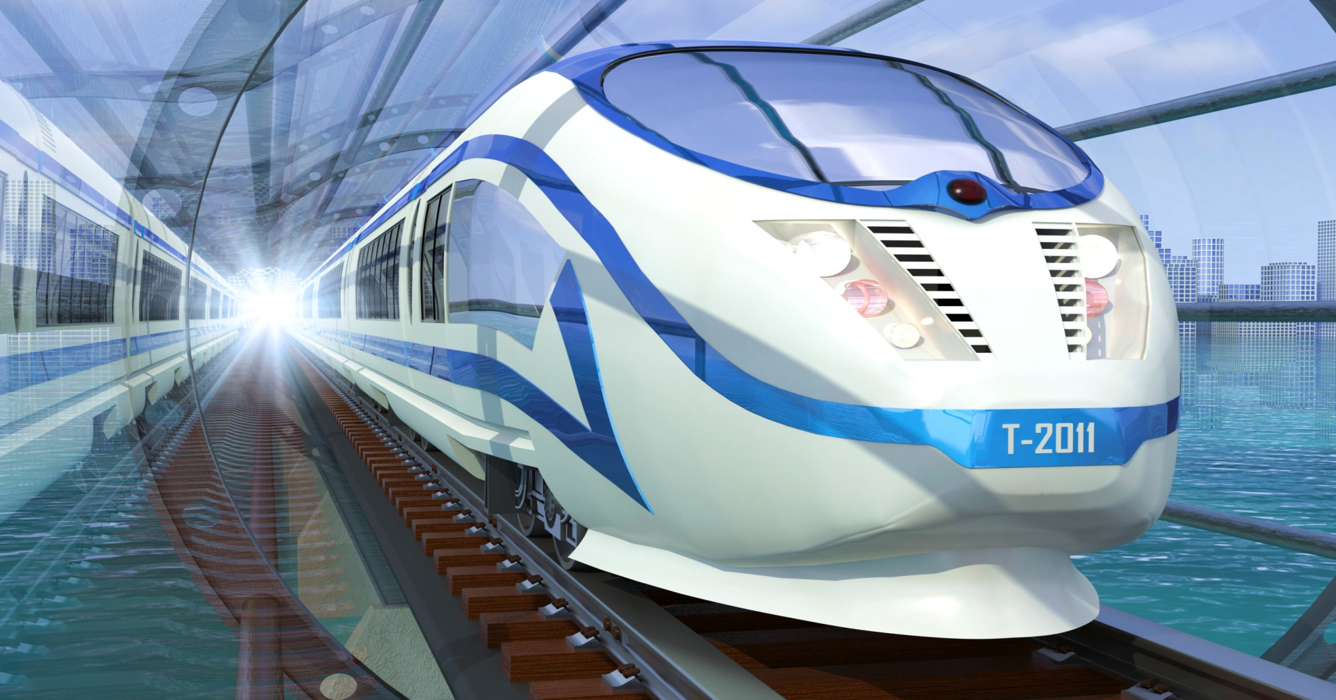
HIGH SPEED GROUND TRANSPORTATION

Slide 7
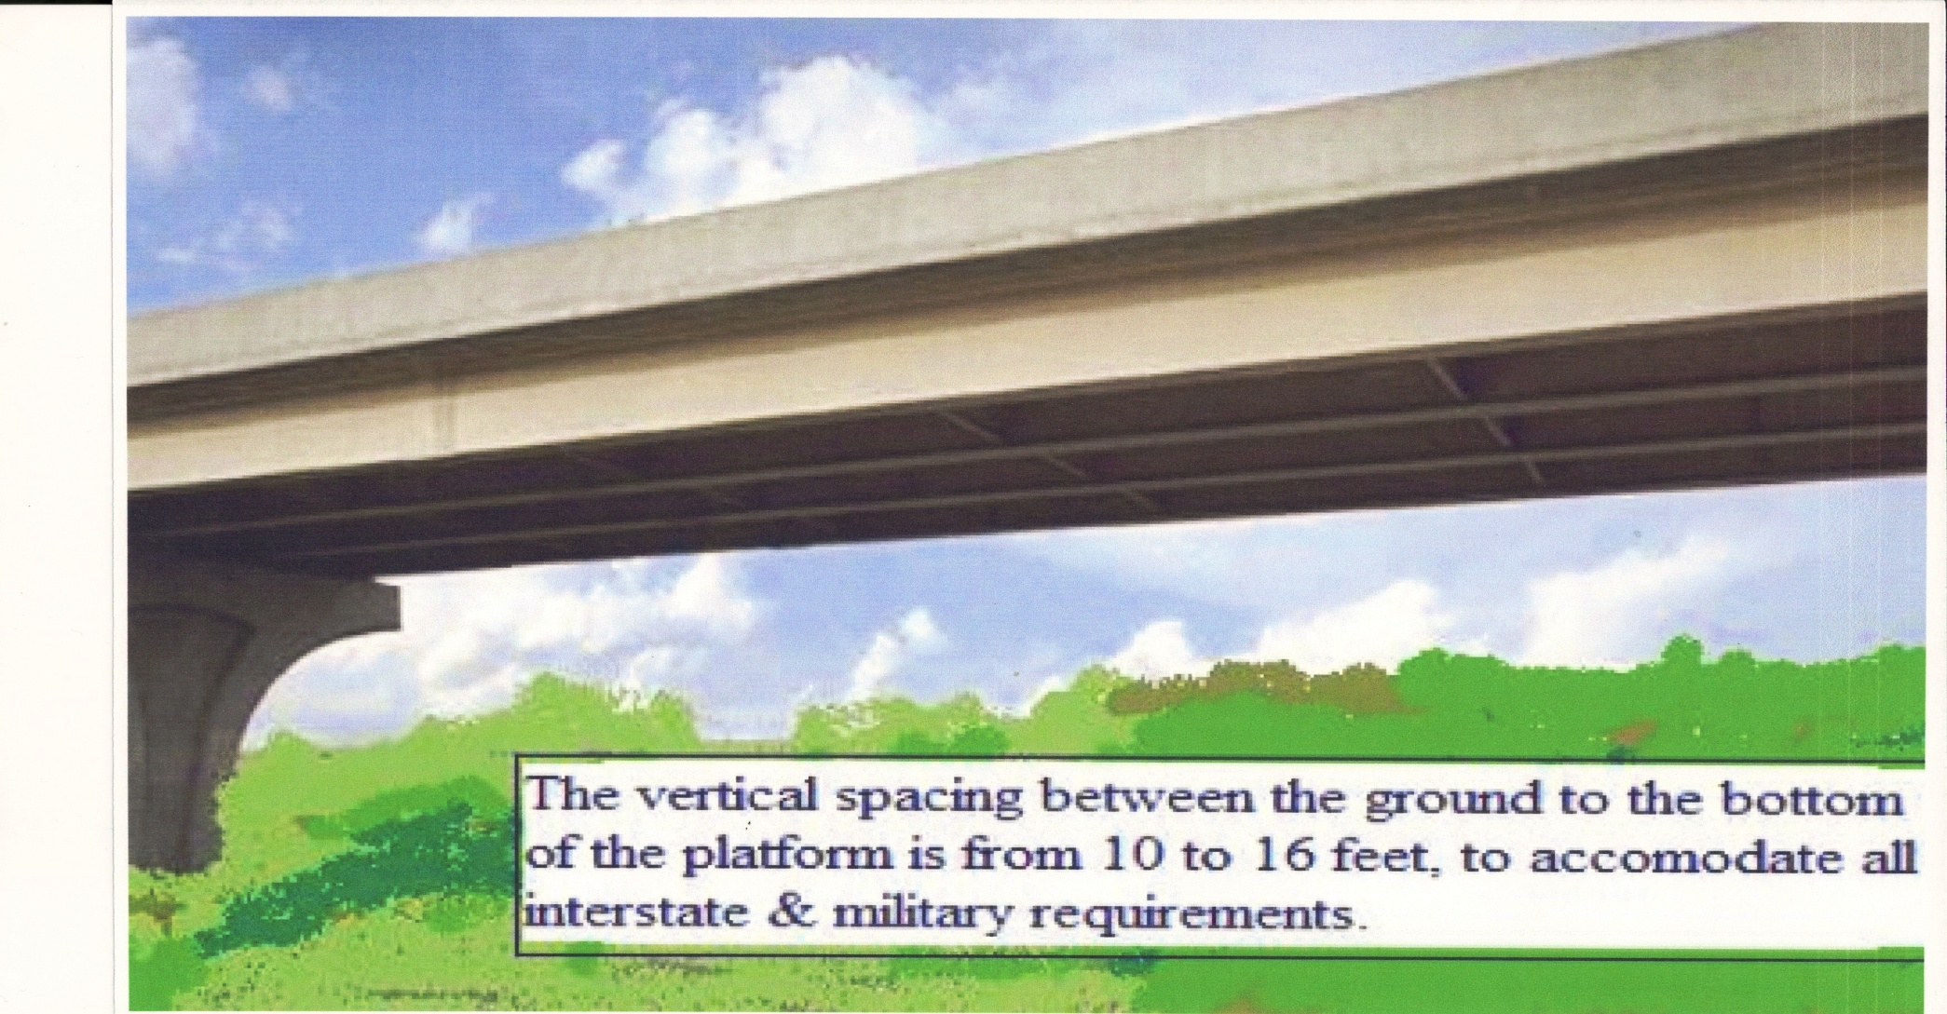
A.N.T.S. PLATFORM

Slide 8
INITIAL ROUTES

Slide 9
FULL ROUTE STRUCTURE

Slide 10

A.N.T.S. BENEFITS

